Slide 1

Automotive Technology: A Systems Approach, 8e
Chapter 14: Lubricating and Cooling Systems
Rob Thompson and Jack Erjavec, Automotive Technology: A Systems Approach, 8th Edition. © 2025 Cengage. All Rights Reserved. May not be scanned, copied or duplicated, or posted to a publicly accessible website, in whole or in part.

Slide 2
Chapter Objectives (1 of 2)
14.01 Name and describe the components of a typical lubricating system.
14.02 Explain the process of flushing the lubrication system.
14.03 Describe the operation of the cooling system.
14.04 List and describe the major components of the cooling system.

Slide 3
Chapter Objectives (2 of 2)
14.05 Inspect the cooling system.
14.06 Test the cooling system for leaks.
14.07 Service components of the cooling system.
14.08 Diagnose the cause of engine overheating.

Slide 4
Lubrication System (1 of 3)
14.01 Name and describe the components of a typical lubricating system.
Engine Oil
  Engine oil is specially formulated to lubricate and cool engine parts.
  The moving parts of an engine are fed a constant supply of oil.
  Engine oil is stored in the oil pan or sump.
  The oil pump draws the oil from the sump and passes it through a filter where dirt is removed.
  The oil is then moved throughout the engine via oil passages or galleries.
  After circulating through the engine, the oil returns to the sump.

Slide 5
Lubrication System (2 of 3)
The oil pump is the heart of the lubricating system.
The oil pump pulls oil from the oil pan through a pickup tube.
The part of the tube that is in the oil pan has a filter screen, which is submerged in the oil and keeps large particles from entering the oil pump.
The pickup may also contain a bypass valve that allows oil to enter the pump if the screen becomes totally plugged.
The pump is normally driven by the crankshaft and creates suction to draw oil from the oil pan through a strainer and then forces the oil through the oil filter and to various passages throughout the engine. The oil then returns to the oil pan.
An oil pump does not create oil pressure; it merely moves oil from one place to another. Oil pumps are positive displacement pumps; that is, the amount of oil that leaves the pump is the same amount that enters it. Output volume is proportional to pump speed.

Slide 6
Lubrication System (3 of 3)
As engine rpm increases, pump output also increases.
As the oil leaves the pump, it passes through many passages which restrict oil flow.
These restrictions are what cause oil pressure.
Small passages cause the pressure to increase; larger ones decrease the pressure.
This is why excessive bearing clearances will decrease oil pressure.
The increased clearances reduce the resistance to oil flow and, consequently, increase the volume of oil circulating through the engine.
This decreased resistance and increased volume lower the pressure of the oil.
Oil pressure is also determined by the viscosity, temperature, and condition of the oil. High-viscosity oil has more flow resistance than low-viscosity oil.

Slide 7
Types of Oil Pumps
Oil pumps are driven by the camshaft or crankshaft and how the pump is driven is dictated by the location of the pump.
Two basic types of oil pumps are used in today’s engines.
A rotor-type oil pump has an inner rotor and an outer rotor.
Gear-type pumps use a drive gear, connected to an input shaft, and a driven gear.

Slide 8
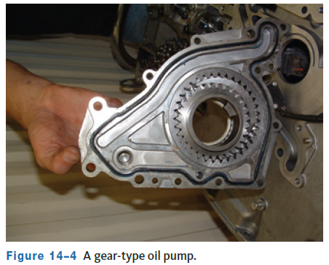
Rotor Type Oil Pumps
  When the rotors turn and the rotors’ lobes unmesh, oil is drawn into that space.
  As the rotors continue to turn, oil becomes trapped between the lobes, cover plate, and top of the pump cavity.
  It is then forced out of the pump body by the meshing of the lobes.
Notes:
.

Slide 9
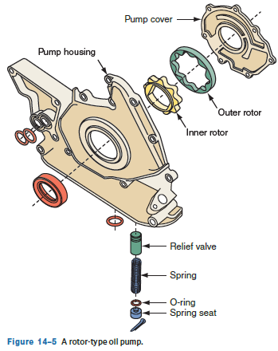
Gear Type Oil Pumps
Both gears trap oil between their teeth and the pump cavity wall. As the gears rotate, oil is forced out as the gear teeth unmesh.
The output volume per revolution depends on the length and depth of the gear teeth.
Another style of gear-type oil pump uses an idler gear with internal teeth that spins around the drive gear.

Slide 10
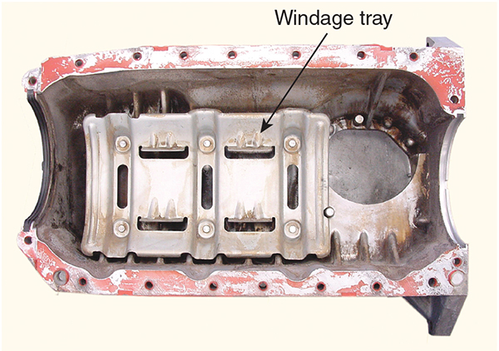
Oil Pan or Sump
The oil pan serves as the reservoir for the engine’s oil and is designed to hold a certain amount of oil.
  Oil is drawn out by the oil pump.
  After the oil moves through the engine’s lubrication circuits, it drains back into the pan.
This describes a wet sump oil system because the sump always has oil in it.
With a wet sump, oil can slosh around during hard cornering or braking which makes it is possible for the oil to move away from the oil pump’s pickup.
This will cause a temporary halt in oil flow through the engine, which can destroy it. To help prevent sloshing, many engines have baffles (windage trays) in the oil pan to limit the movement of the oil.

Slide 11
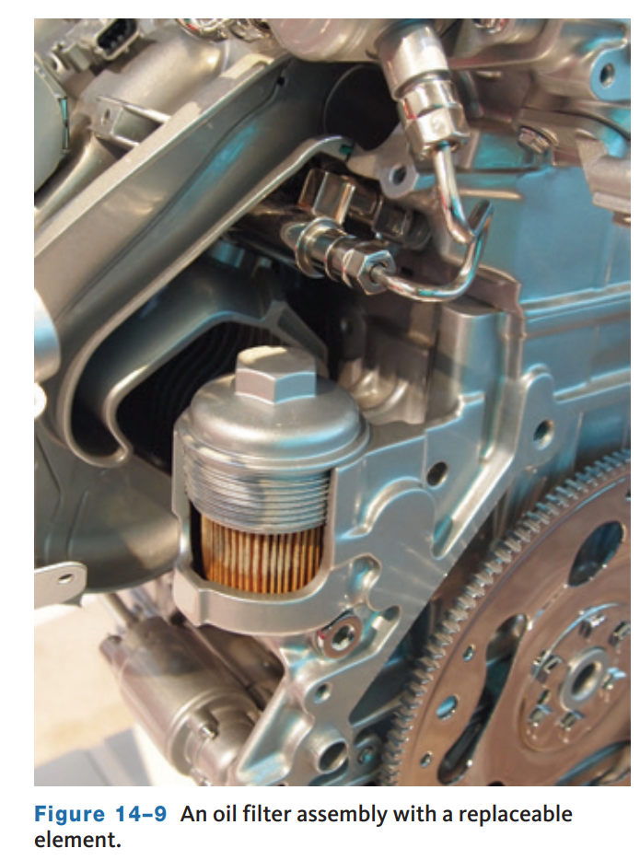
Oil Filter
As the oil leaves the oil pump, it flows through an oil filter which prevents small particles of dirt and metal suspended in the oil from reaching the close-fitting engine parts.
If the impurities are not filtered from the oil, the engine will wear prematurely and excessively.
The oil filter is typically a disposable metal container filled with a special type of treated paper or other filter substance (cotton, felt, and the like).
All of the oil going through the engine goes through the filter first. However, on cold engine startup, or if the filter becomes plugged, a relief valve in the filter will open and allow oil to bypass and go directly to the engine’s oil passages.
This provides the engine with necessary, though unfiltered.

Slide 12
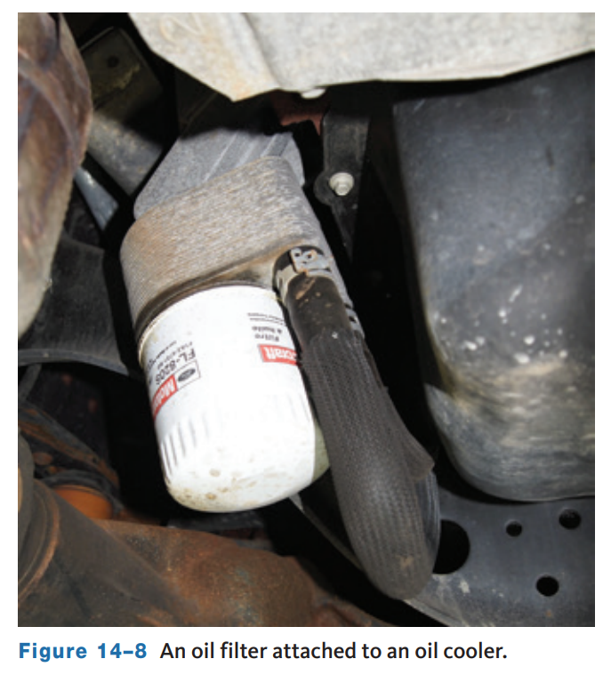
Oil Coolers
To control oil temperature, many diesel, high-performance, and super- or turbocharged engines have an external engine oil cooler.
Hot oil mixed with oxygen breaks down (oxidizes) and forms carbon and varnish.
The higher the temperature, the faster these deposits build.
Oil flows from the pump through the cooler and then to the engine.
An oil cooler is a small radiator mounted near the front of the engine or within the radiator.
Heat is removed from the oil as engine coolant flows around the cooler and air passes through it.

Slide 13
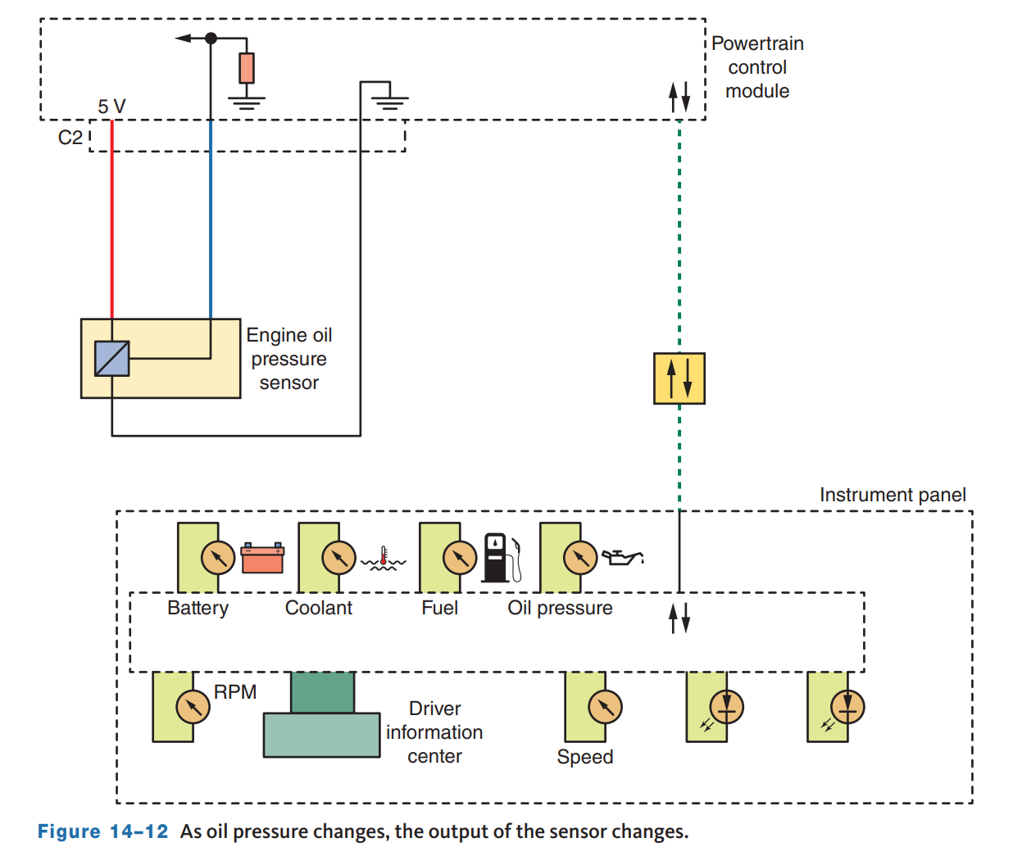
Oil Pressure Indicator
Oil gauges are either mechanically or electrically operated and display the actual oil pressure of the engine.
The indicator light warns the driver of low oil pressure.
In a mechanical gauge, oil travels up to the back of the gauge where a flexible, hollow tube, called a Bourdon tube, uncoils as the pressure increases.
Most pressure gauges are electrically controlled.
An oil pressure sensor or sending unit is screwed into an oil gallery. As oil passes through an oil pressure sender, it moves a diaphragm, which is connected to a variable resistor. This resistor changes the amount of current passing through the circuit. The gauge then reacts to the current and moves a needle over a scale to indicate the oil pressure, or the current is translated into a digital reading on the gauge.

Slide 14
Oil Consumption
Excessive oil consumption can result from external and internal leaks or worn or stuck piston rings, valve seals, or valve guides.
Internal leaks allow oil to enter the combustion chamber where it is burned.
Blue exhaust smoke is an indication that an engine is burning oil.
If the valve guides are worn or the valve seals are worn, cracked, or improperly installed, oil will be drawn into the cylinder during the intake stroke.
If there are worn or broken piston rings or worn cylinder walls, the affected cylinders will have low compression.
The oil in the cylinder also tends to foul the spark plugs, which will cause misfires, high emissions, and possible damage to the catalytic converter.
External leaks are a common cause of excessive oil consumption.
These leaks can occur at the valve or cam cover gasket, head gasket, oil filter, front and rear seals, oil pan gasket, and timing gear cover.
Pressure develops when the positive crankcase ventilation (PCV) system is not working properly and can cause various oil leaks.

Slide 15
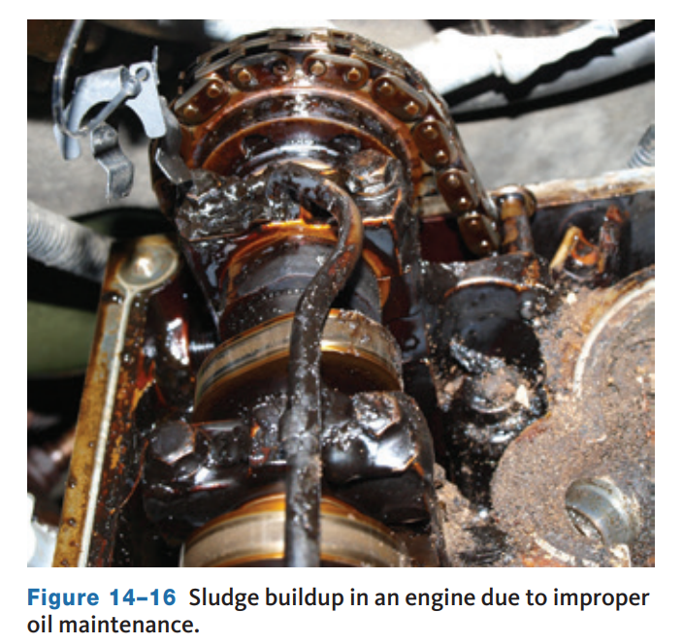
Sludge
A typical sign of poor maintenance is the buildup of yellow sludge inside the engine.
Sludge results from the oxidation of oil. When oil oxidizes, chemical compounds in the oil begin to break down and solidify, forming a gel substance.
The gelled oil cannot circulate through the engine and collects on engine parts. This buildup of sludge can also block normal lubrication paths.
If the sludge on the filler cap is white, suspect a blown head gasket. The whitish gel is caused by coolant mixing with the oil.
Often, sludge can be removed by flushing the system. However, if the buildup is great, the engine should be torn down and cleaned.

Slide 16
Flushing the System
14.02 Explain the process of flushing the lubrication system.
Flushing the lubrication system periodically is recommended by some manufacturers. However, there are others that do not recommend flushing the engine.
It involves running a solvent through the engine and then draining the system.
The concern of those who do not recommend flushing is simply that the solvents may loosen up some dirt or sludge that will not drain out with the oil.
These contaminants can block oil ring return holes and restrict oil flow. Oil flushing solvents can be added to the engine’s oil before an oil change.
Flushing machines connect to the filter housing and the drain plug port after the old oil has been drained.
A heated solution is pumped through the oil reservoir, passages, oil pump, and up into the valve train.
Solvent back flushes the oil pump and pickup screen, breaks up, and dissolves the sludge.
The remains are drawn out by a vacuum.
After flushing, a new oil filter and clean oil are put into the engine.

Slide 17
Discussion
Now that you have learned about the lubrication system, have a discussion with your class.
Name the parts and components of the lubrication system. Discuss their function. Discuss some of the possible symptoms that a failure of each of these components would cause.

Slide 18
Cooling Systems (1 of 2)
14.03 Describe the operation of the cooling system.
Today’s engines create a tremendous amount of heat, most of which is generated during combustion.
Metal temperatures around the combustion chamber can run as high as 1,000 °F.
This heat can destroy the engine and must be removed which is the purpose of the engine’s cooling system.
The system must also allow the engine to quickly warm up to a desired operating temperature and keep it there regardless of operating conditions.
Heat is removed by a heat-absorbing liquid (coolant) circulating inside the engine. Coolant then flows to the radiator where its heat is transferred to the outside air.
A pump moves the coolant through the engine block and then through the cylinder head.
The coolant flows to the top of the radiator and loses heat as it flows down through the radiator where airflow from the cooling fan carries heat away.

Slide 19
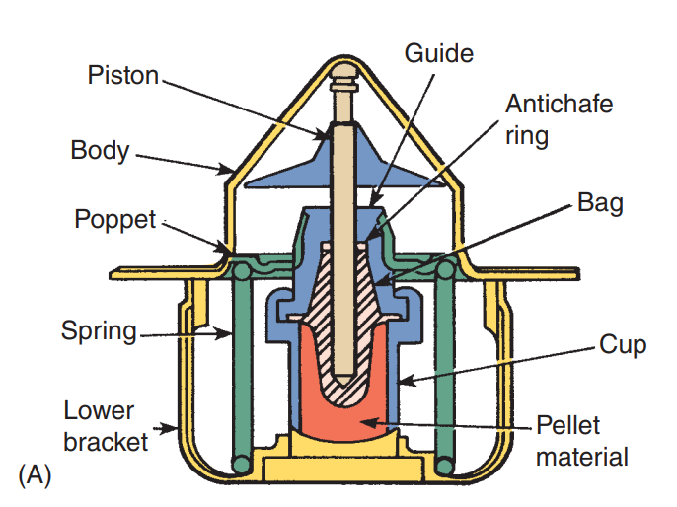
Cooling Systems (2 of 2)
14.04 List and describe the major components of the cooling system.
The thermostat controls the minimum operating temperature of the engine.
A thermostat is a temperature-responsive coolant flow control valve. It controls the temperature and amount of coolant entering the radiator.
While the engine is cold, the thermostat is closed, allowing coolant to only circulate in the engine. This allows the engine to uniformly warm up.
When the coolant reaches a specified temperature, the thermostat opens and allows coolant to flow to the radiator.
The hotter the coolant gets, the more the thermostat opens, sending more coolant to the radiator.

Slide 20
Thermostat
Once the coolant passes through the radiator, it reenters the water pump.
From there, it is pushed through the engine and the cycle starts again.
The thermostat permits fast engine warmup. Slow warmup causes condensation in the crankcase, which can cause sludge.
Today’s thermostats have a specially formulated wax and powdered metal pellet contained in a heat-conducting copper cup that has a piston inside a rubber boot. Heat causes the wax to expand, forcing the piston outward, which opens the thermostat’s valve. The pellet responds to temperature changes and moves the valve to control coolant temperature and flow.
Thermostats are also designed to slow the flow of coolant when they are open. This prevents the coolant from moving too quickly through the engine. Fast-moving coolant may not have enough time to absorb heat, and therefore, overheating can result.
Modern diesel engines may have two thermostats to control engine temperature more precisely. One thermostat has an opening temperature slightly above the other, such as 180 °F (82.2 °C) and 185 °F (85 °C).

Slide 21
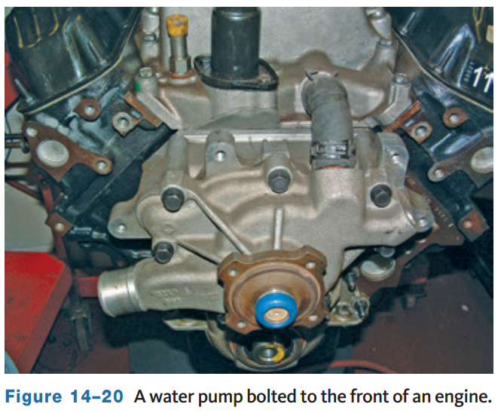
Water Pump
Water Pump
  The heart of the cooling system is the water pump.
  Its job is to move the coolant through the system.
  Typically, the water pump is driven by the crankshaft through pulleys and a drive belt.
  The pumps are centrifugal-type pumps with a rotating impeller to move the coolant.

Slide 22
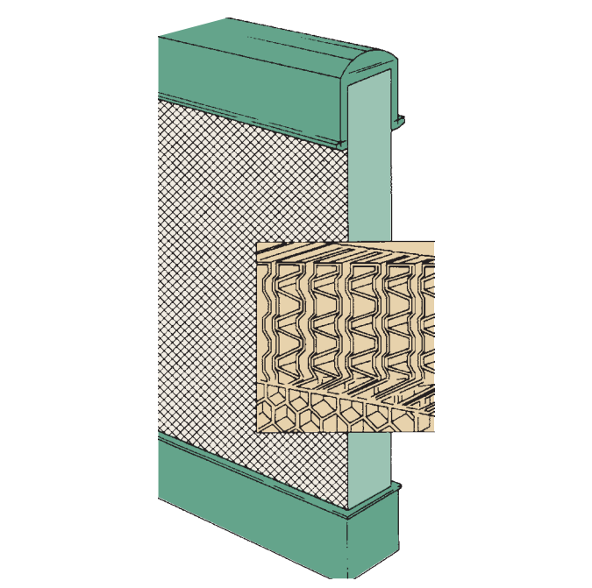
Radiator
The radiator is a heat exchanger, transferring heat from the engine to the air passing through it.
The radiator is a series of tubes and fins (collectively called the core) that expose the coolant’s heat to as much surface area as possible.
Attached to the sides or top and bottom of the core are plastic or aluminum tanks (Figure 14–24). One tank holds hot coolant and the other holds the cooled coolant.
Cores are normally composed of flattened aluminum tubes surrounded by thin aluminum fins. The fins conduct the heat from the tubes to the air flowing through the radiator. Most radiators have drain petcocks or plugs near the bottom.
Coolant is added at the radiator cap or the recovery tank.

Slide 23
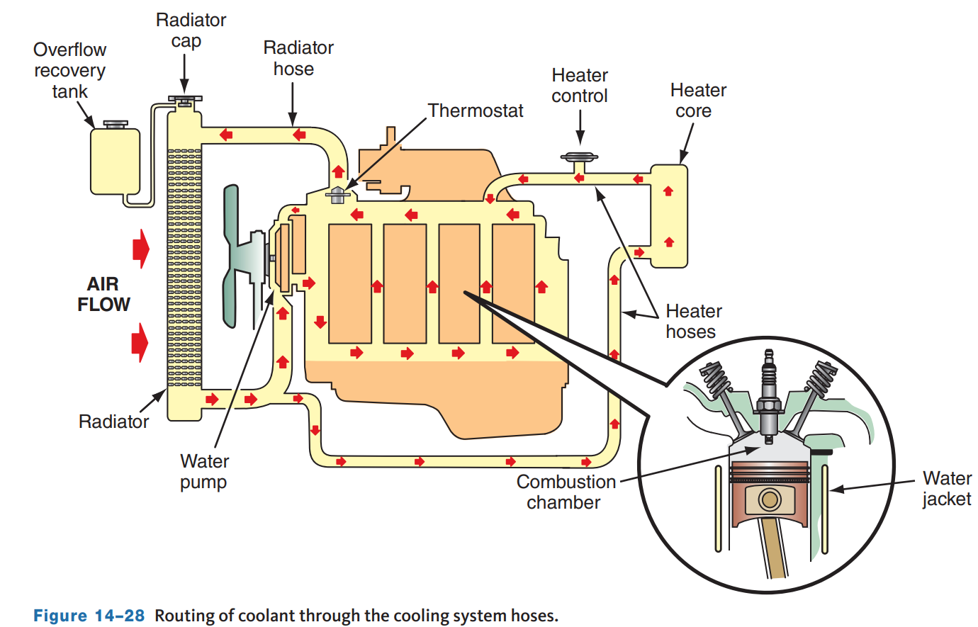
Hoses and Pipes
Coolant flows from the engine to the radiator and from the radiator to the engine through radiator hoses.
The hoses are usually made of butyl or neoprene rubber hoses to cushion engine vibrations and prevent damage to the radiator.
Pipes, typically made from steel, are used to route coolant flow around the inside or outside of an engine, to the heater core, and other places depending on the type of system.
A hose is typically made up of three parts: an inner rubber tube, some reinforcement material, and an outer rubber cover.

Slide 24
Cooling Fans
The efficiency of the cooling system depends on the amount of heat that can be removed from the system and transferred to the air.
At highway speeds, the ram air through the radiator should be sufficient to maintain proper cooling.
At low speeds, the system needs additional air which is delivered by a fan.
The fan may be driven by the engine, via a belt, driven by an electric motor, or hydraulically through the power-steering system.
A belt-driven fan is bolted to a pulley on the water pump and turns constantly with the engine. Thus, belt-driven fans always draw air through the radiator from the rear.
Engine drive fans utilize a fan clutch located between the water pump pulley and the fan. When the engine and fan clutch are cold, the fan moves independently from the clutch and moves little air. The clutch locks the fan to its hub when the temperature of the air around the fan reaches a particular point.

Slide 25
Cooling System Diagnosis (1 of 2)
14.05 Inspect the cooling system.
The cooling system must be inspected and serviced as a system.
Replacing one damaged part while leaving others dirty or clogged will not increase system efficiency.
Diagnosis of the system involves both a visual inspection of the parts, simple checks and tests, and leak testing.
One of the first checks of the cooling system is the checking of coolant level and condition.
These checks should be done during normal preventive maintenance and when there is a problem.

Slide 26
Cooling System Diagnosis (2 of 2)
Testing for Electrolysis in Cooling Systems.
Electrolysis is a process in which an electrical current is passed through water, causing the separation of hydrogen and oxygen molecules.
In older vehicles with cast iron engines and copper and brass radiators, electrolysis can be a concern. In a cooling system, electrolysis removes the protective layer on the inside of the radiator tubes. It also can cause serious engine failures.
Electrolysis occurs when there is improper grounding of electrical accessories and equipment or static electricity buildup allows the current to flow through the cooling system.
Modern radiators typically mount on rubber bushings which isolate the radiator from the electrical system. If electrolysis is suspected, use a voltmeter that is capable of measuring AC and DC voltage.

Slide 27
Inspection of Cooling System (1 of 3)
The most common cooling system problem is overheating which can be caused my many different things.
Diagnosis of this condition involves many steps, simply because many things can cause this problem.
Basically, overheating can be caused by anything that decreases the cooling system’s ability to absorb, transport, and dissipate heat:
  The first step is to determine whether the engine is indeed overheating. An overheating concern normally begins with high readings on the vehicle’s temperature gauge or the illumination of the temperature warning lamp.
  These can be caused by a cooling system problem or a faulty temperature sensor, although when the engine is greatly overheating, it is obvious by the steam emitted by the system or by smell.
  The best way to check the accuracy of the temperature indicators is to measure the temperature of the coolant.

Slide 28
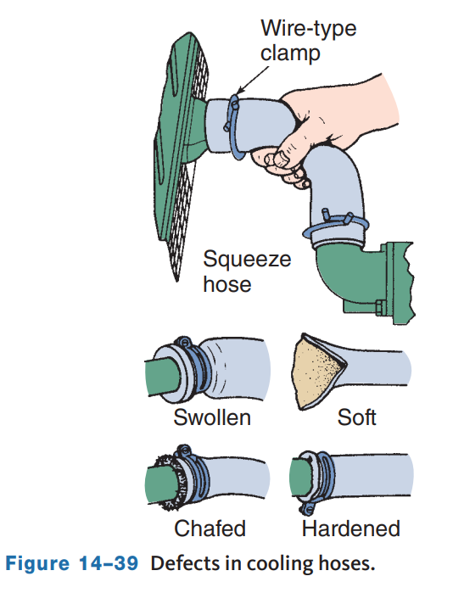
Inspection of Cooling System (2 of 3)
Checking Hoses
  Carefully check all cooling hoses for leakage, swelling, and chafing.
  Also replace any hose that feels mushy or extremely brittle when squeezed firmly.
  When a hose becomes soft, it is deteriorating and should be replaced before more serious problems result.
  Hard hoses will resist flexing and may crack rather than bend and should be replaced.

Slide 29
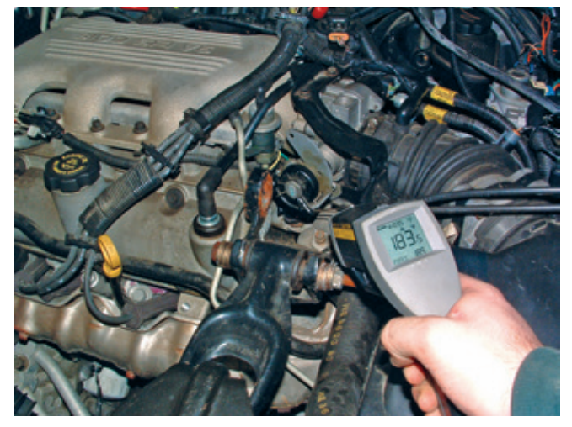
Inspection of Cooling System (3 of 3)
Thermostats are often the cause of overheating or poor heater performance.
They can also cause an increase in fuel consumption and poor engine performance.
If the thermostat is stuck open, the coolant may not reach the desired temperature because it is cooled before it gets hot.
Often, a P0128 DTC will be stored in the PCM if the thermostat is stuck open or opens too soon.
The best way to check thermostat operation is to measure engine temperature with an infrared thermometer. However, you can use your hand to feel the temperature.

Slide 30
Knowledge Check (1 of 2)
What is the job of the water pump?

Slide 31
Knowledge Check Answer (1 of 2)
Answer: Its job is to move the coolant through the system.

Slide 32
Testing for Leaks (1 of 2)
14.06 Test the cooling system for leaks.
A radiator pressure tester is a common tool used to test a cooling system.
It is extremely handy for finding the source of any leak in the cooling system. The tester applies pressure to the entire cooling system.
A good cooling system should be able to hold its rated pressure for 15 minutes or more without losing pressure.
The tester is fastened to the radiator filler neck or degas bottle. The engine runs until it is warm.
If the pressure drops off, there is a leak. Carefully check the hoses, radiator, heater core, and water pump for leaks.
Often, the leak will initially be obvious because coolant will spray out of the leak. Also look for bulges in the hoses.
The source of internal leaks is found through additional testing. An internal leak caused by a bad head gasket can be verified with the tester.

Slide 33
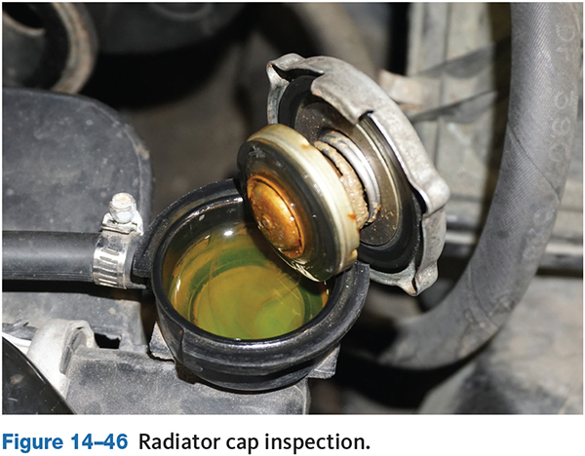
Testing for Leaks (2 of 2)
The opening pressure of the radiator cap should be measured and the cap checked for gasket cracking, brittleness, or deterioration.
Also check the sealing surfaces in the radiator filler neck.
Over time, the spring in the cap can weaken and that will lower the coolant’s boiling point.
This will cause the engine to lose coolant through the overflow tube whenever it gets hot.
To check the cap, install the correct cap adapter and the radiator’s pressure cap to the tester head. Pump the tester until the gauge reads the pressure rating of the cap.
The cap should hold that pressure for at least 1 minute.

Slide 34
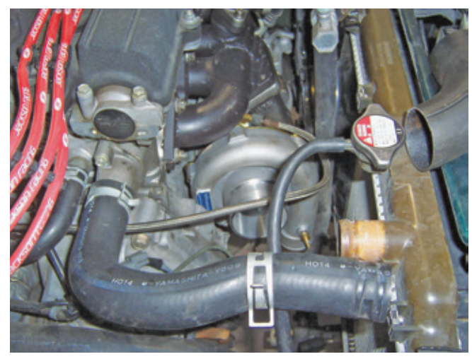
Cooling System Service (1 of 4)
Hoses must be made of the right material and have the correct diameter, length, and shape.
The hose’s part number is often printed on the outside of the hose, and replacement hoses should correspond to those numbers.
Nearly all OEM hoses are of the molded, curved design. Molded hoses designed to fit many applications are often sold.
Aftermarket hoses are either molded or flex types.
A flex-type hose allows greater vehicle coverage per part number.
Do not reuse clamps, even if they look good.

Slide 35
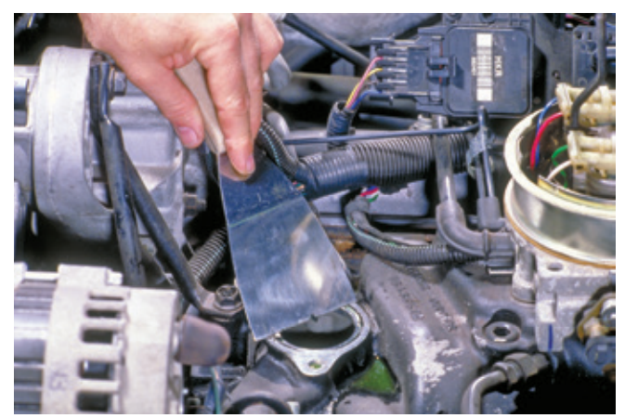
Cooling System Service (2 of 4)
Thermostat
  When replacing the thermostat, the replacement should always have the same temperature rating as the original.
  Also replace the gasket that seals the thermostat in place and is positioned between the thermostat housing and the block.
  Make sure the mating surfaces on the housing and block are clean.

Slide 36
Cooling System Service (3 of 4)
Repairing and Replacing Radiators
Most radiator leak repairs require the removal and replacement of the radiator.
Many vehicles with automatic transmissions have fluid cooler lines attached to the radiator. Place a separate drain pan under the transmission cooler lines when removing.
Remember to check and top off the transmission fluid after the cooling system is repaired. Many of today’s radiators have aluminum cores and plastic tanks, which are not repaired. If these tanks leak, they are replaced.
If the radiator is badly damaged, it should be replaced.
The actual radiator repair procedures depend on its construction and the type of damage. Most repairs are made by radiator specialty shops whose technicians have knowledge of such work.
Exercise caution when working with radiators, the aluminum is very sharp.

Slide 37
Cooling System Service (4 of 4)
When replacing a water pump, make sure the replacement is the correct one.
Before replacing a water pump, the cooling system should be drained. Remove all parts that will interfere with the removal of the pump. This includes the drive belts, fan, fan clutch, fan shroud, and pump pulley. Special fan clutch tools are often required to remove the fan from water pump shaft.
Most pumps are bolted to the block. Loosen and remove the bolts in a crisscross pattern from the center outward. Insert a rag into the block opening and scrape off any remains of the old gasket.
When replacing a water pump, always follow the procedures given by the manufacturer.
Most often, a coating of adhesive is applied to a new gasket before it is placed into position on the water pump.
Some pumps are sealed to the block with an O-ring. Make sure the O-ring groove in the block is clean. When installing the O-ring, make sure it is totally inserted in the groove. Lubricate the O-ring to prevent it from tearing during installation.
Install the bolts and tighten them evenly in a sequence to the torque specification.

Slide 38
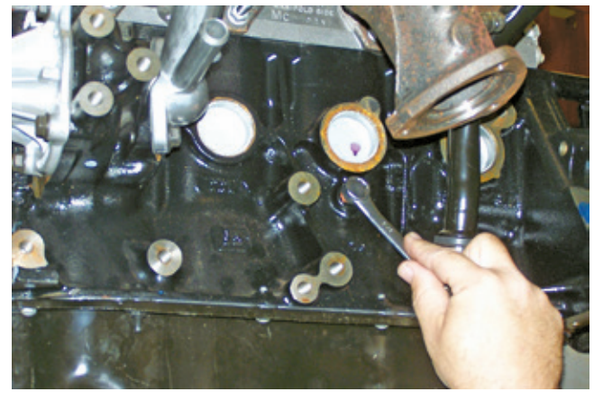
Draining the Coolant
Part of a preventive maintenance program is changing the engine’s coolant which is done to prevent the coolant from breaking down chemically.
Most radiators have a drain plug located in the lower part of a tank. Some have a petcock valve.
If the radiator does not have a drain plug, remove the lower radiator hose. Be careful not to force the hose away from the radiator.
Additional coolant can be drained through drain plugs in the engine block.
Place the catch can below the drain plug and remove the plug.

Slide 39
Refilling and Bleeding
After the cooling system has been drained and all services performed, the system needs to be refilled with the proper type and mixture of coolant.
It is important that the correct type is put into the system, and the color of the coolant does not necessarily indicate its purpose.
Fill the system with the correct coolant, then loosely install the radiator cap. Run the engine until it reaches operating temperature.
Then turn it off and correct the level of the coolant. Tighten the radiator cap and run the engine again and check for leaks. When refilling the system, be sure you get it completely full.
Some systems are difficult to fill without trapping air. Air pockets in the head(s), heater core, and below the thermostat can prevent proper coolant flow and cooling.
Sometimes jacking up the front of the car will raise the radiator cap higher than the rest of the cooling system which helps to bleed air out of stubborn systems.
Each vehicle may its own specific bleeding procedure.
Some engines have air bleed valves located at the high point in the system.

Slide 40
Special Precautions for Hybrid and Electric Vehicles
Special coolants are required in most hybrids which often have two different cooling system circuits.
On some, one coolant cools both the engine and the converter/inverter assembly.
Cooling the converter/ inverter is important, and checking its coolant condition and level is an additional check during preventive maintenance.
The cooling systems used in some hybrids feature electric pumps and storage tanks. The tanks store heated coolant and can cause injury if the technician is not aware of how to carefully check them.
To properly service the cooling systems on many hybrid vehicles, you will need a scan tool and the correct service information to perform even a coolant drain and refill.
Battery cooling systems on electric vehicles (EVs) do not require the same service as those for combustion engines but do require knowledge of how the systems operate and proper service procedures.

Slide 41
Knowledge Check (2 of 2)
What would be the likely symptom of a vehicle with a stuck open thermostat?

Slide 42
Knowledge Check Answer (2 of 2)
It would not reach full operating temperature, and the heat may blow cold inside the vehicle.
Thermostats are often the cause of overheating or poor heater performance.
They can also cause an increase in fuel consumption and poor engine performance.
If the thermostat is stuck open, the coolant may not reach the desired temperature because it is cooled before it gets hot.
Often, a P0128 DTC will be stored in the PCM if the thermostat is stuck open or opens too soon.

Slide 43
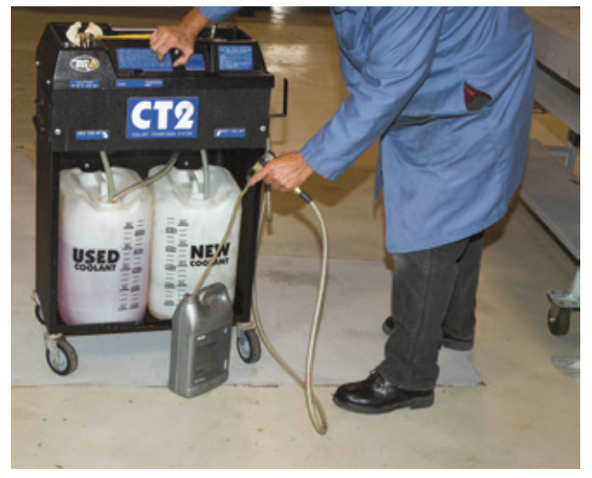
Coolant Exchangers
A coolant exchanger is used to remove old coolant from the system and replace it with new coolant at the correct mixture.
Some coolant exchangers will also leak test the system and flush it.
Coolant exchangers are normally powered by shop air.
Most exchangers move through their cycles with the engine off.

Slide 44
Chapter Reflection
Please take a moment to compare your perception of the cooling and lubrication systems before and after studying this chapter. Respond to the following questions in one or two paragraphs. Use 150–200 words in your reflection.
Did you find anything about the lubrication system difficult to understand? How will you better your understanding?
Did you find anything about the cooling system difficult to understand? How will you better your understanding?

